Slide 1
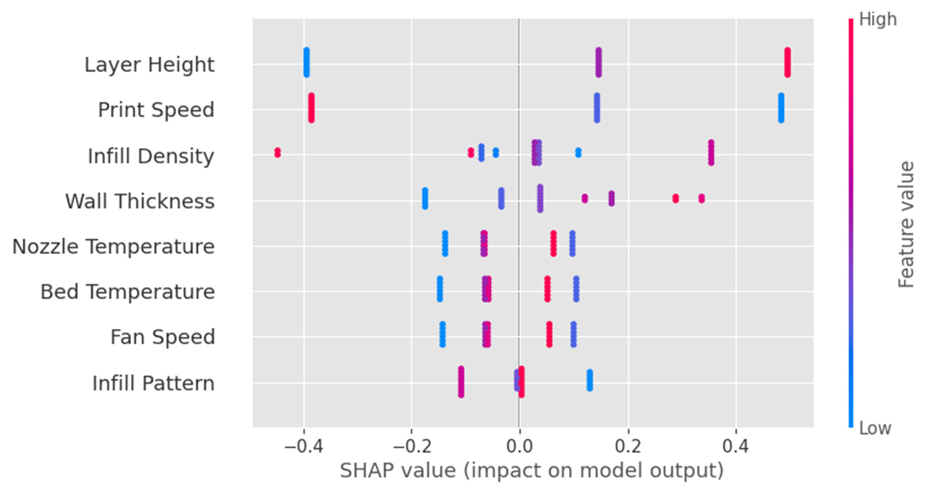
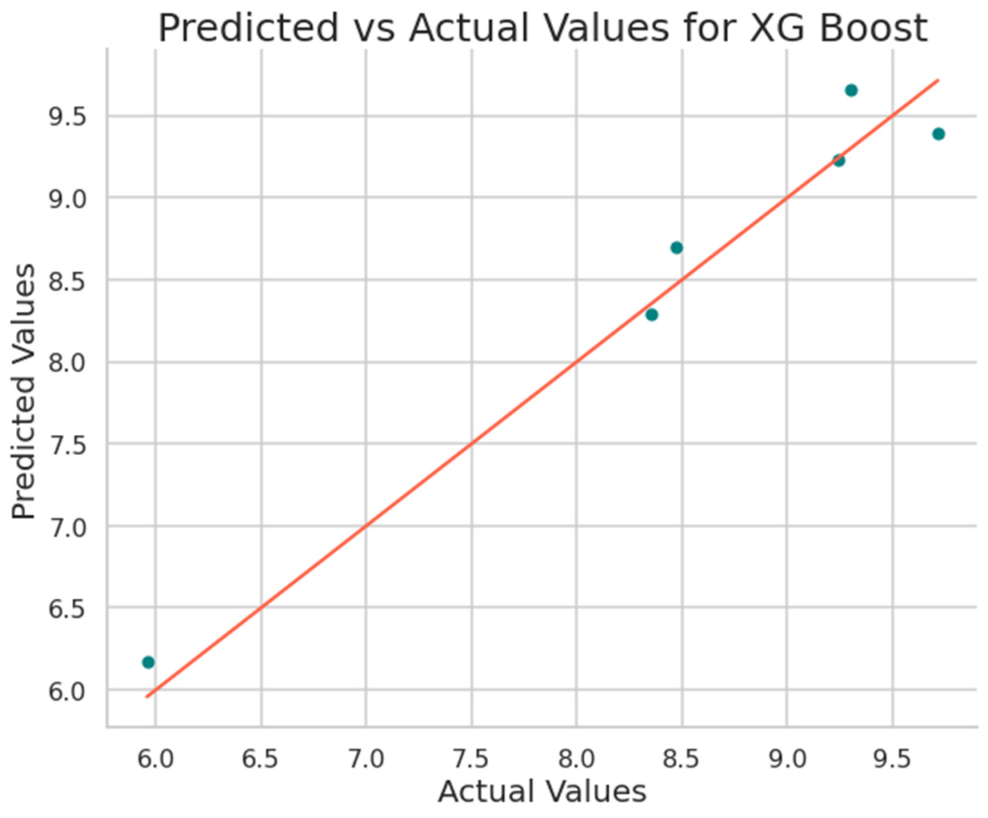
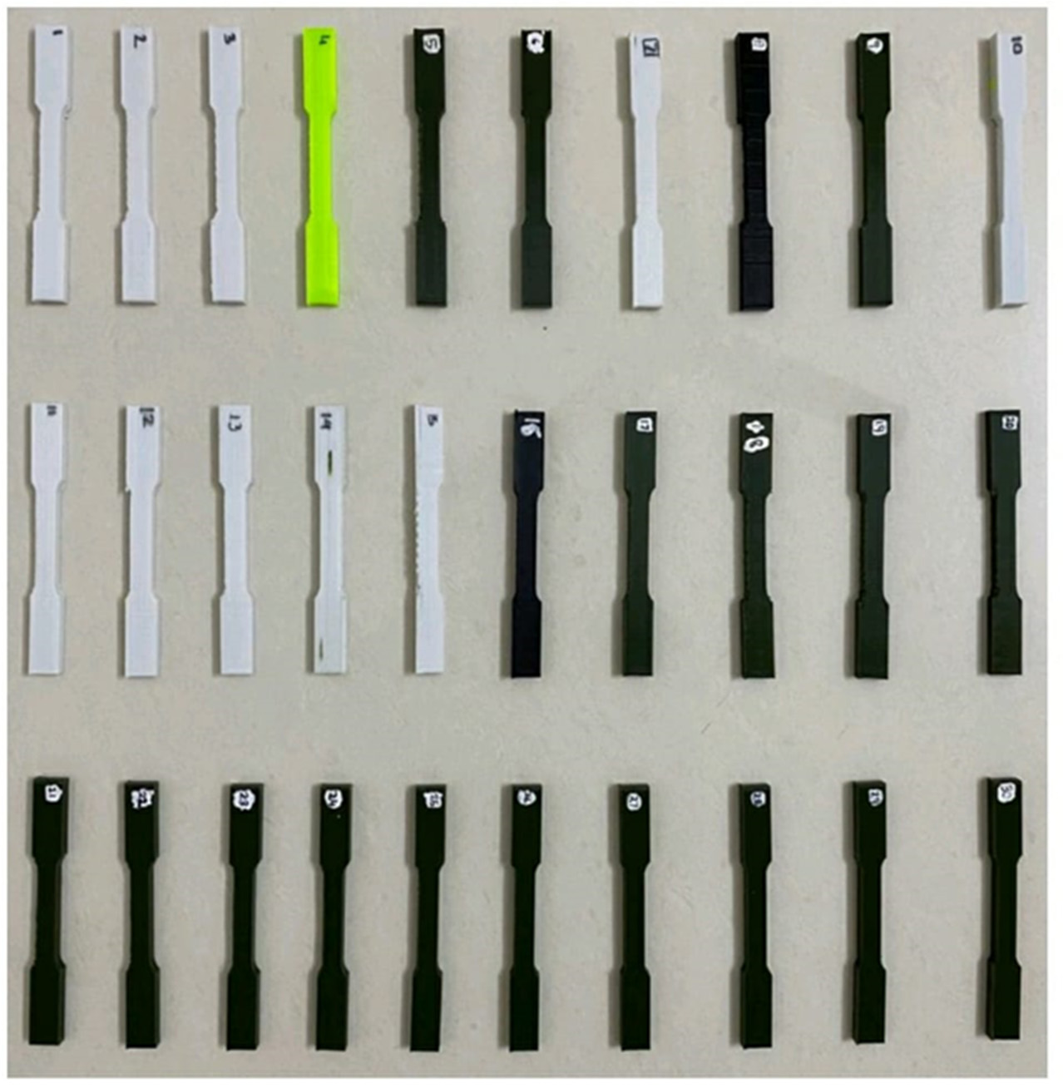
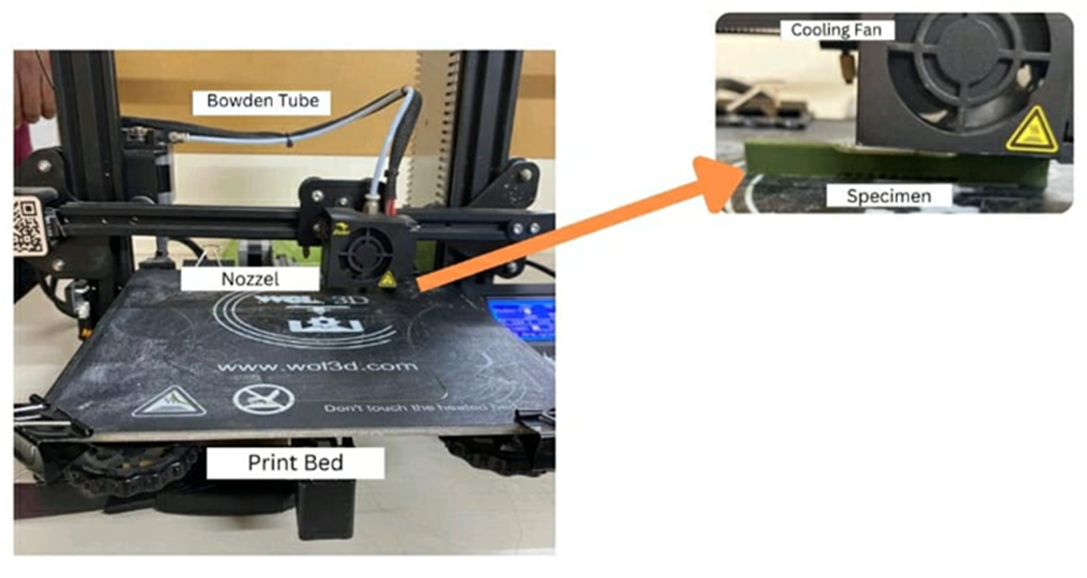
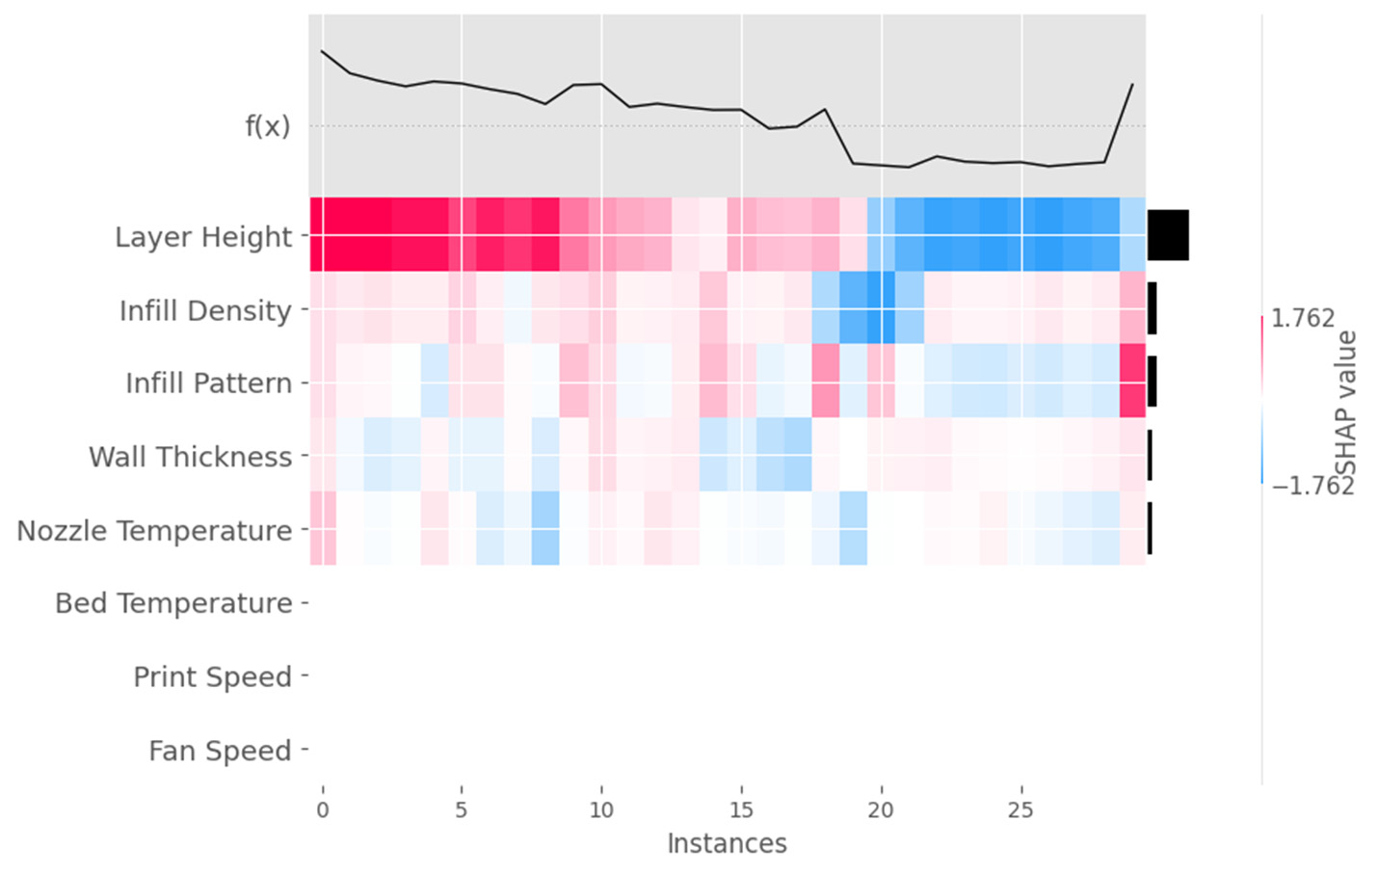
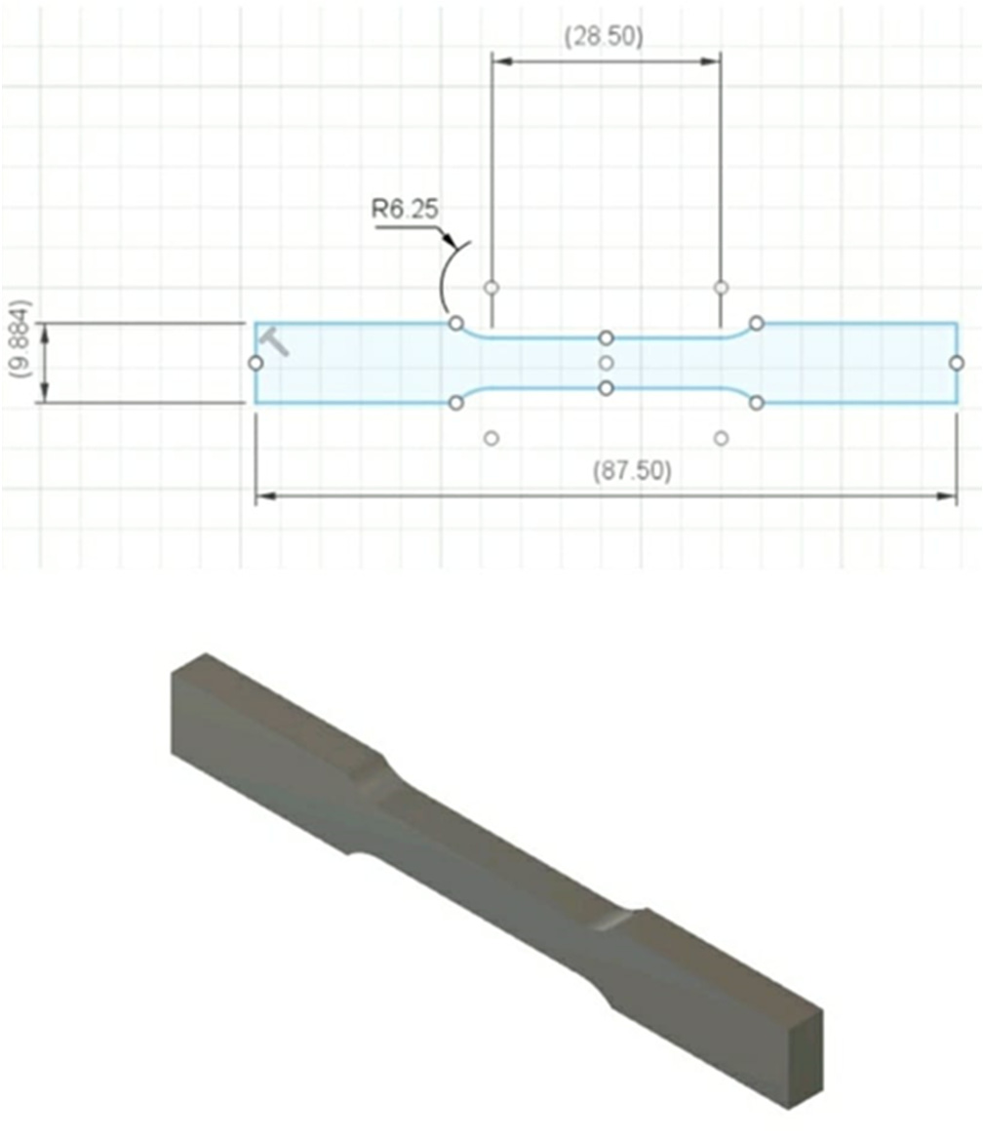
Design Optimization, Additive Manufacturing Technologies & applications| 5th Computational Methods and Ocean Technology (COTech 2026)
Explainable Artificial Intelligence and Supervised Machine Learning for Surface Roughness Prediction of Additively Manufactured PLA Specimens
Kifle Mesfin*
Bahir Dar University, Ethiopia
CENTRAL FINDING
0.9634
0.0558
0.1992
XGBoost captured 96.34% of the variation in measured PLA surface roughness.
R²
MSE
MAE
Research question
Machine-learning workflow
Explainable AI reveals process influence
Can surface roughness in FDM-printed PLA be predicted accurately while keeping the model transparent enough for engineering decisions?
01 RSM trials → 02 Eight inputs → 03 80/20 split → 04 Nine regressors → 05 XAI interpretation
SHAP values connect each process setting to the direction and magnitude of its contribution to the predicted surface roughness.
Surface roughness influences wear, reliability, appearance, and the structural performance of additively manufactured components.
SVR • Decision Tree • Random Forest • XGBoost • CatBoost • AdaBoost • Extra Tree • Gradient Boosting • Explainable Boosting Machine
Experimental design
Nine-model benchmark
• 30 PLA specimens generated by response surface methodology
• ASTM E8 geometry uniformly reduced by 50%
• Surface roughness averaged across four measurement locations
• Mitutoyo SJ-10 tester used for the response measurement
XGBoost SHAP beeswarm: global feature impact
XGBoost predicted vs. actual values
Creality FDM printing setup
Best overall model
XGBoost
Thirty printed PLA specimens
Lowest MSE and MAE, and the highest R² among all nine regressors.
Scaled ASTM E8 specimen geometry
What the benchmark means
SHAP heatmap: instance-level feature contributions
Tree-based ensembles dominated the comparison. Random Forest, Extra Tree, Gradient Boosting, and AdaBoost all achieved R² values near or above 0.89, but XGBoost produced the clearest improvement in prediction accuracy.
Interpretation
Eight process inputs
• Layer height showed the widest SHAP spread and the strongest overall influence.
• Print speed was the second most influential input.
• Infill density and wall thickness showed moderate, instance-dependent effects.
• Bed temperature, fan speed, and infill pattern contributed less within the investigated design space.
Layer height
Wall thickness
Infill density
Infill pattern
Nozzle temperature
Bed temperature
Print speed
Fan speed
Evaluation metrics: mean squared error (MSE) | mean absolute error (MAE) | coefficient of determination (R²)
1 Accurate
2 Interpretable
3 Actionable
Kifle Mesfine|*
jowalt965@gmail.com
XGBoost achieved R² = 0.9634.
SHAP exposed how each process input affected prediction.
Layer height and print speed are priority controls.

