Slide 1

Velkommen til Fysikk-OL trenings-uke!
Universitetet i Stavanger

Slide 2
Hvem er vi?
Anders Tranberg, Universitetet i Stavanger.
Underviser i Astronomy og Forkurs-fysik.
Forsker på kvantefeltteori og det første sekund efter Big Bang.
Sigve Runde Barlaug, Lillestrøm vgs
Felix Pham, Stabekk vgs
Elly Kjelstrup, Kongsbakken vgs
Edvin Brattlid-Roseng, Horten vgs
Øystein Berntzen, Elvebakken vgs
Don Thai Hoang, St. Olav vgs
Snorre Wilhelmsen, Kongsbakken vgs
Jørand Runningen, Drammen vgs
Marius Røkke, Thora Storm vgs
Frederik Ådlandsvik, Amalie Skram
Tarjei Nordbø Braut, Stavanger Katedralskole
Adrian Hestnes, Sørumsand vgs
Kassander Auve, Sandefjord vgs
Håkon Støren, St, Svithun vgs
Mathias Gustafson, Ullern vgs
Ricardo Guiraudeli, Blindern vgs
Samuel Bjerke, Nydalen vgs

Slide 3
The Plan (https://indico.uis.no/event/45/)
 | Mandag | Tirsdag | Onsdag | Torsdag | Fredag
08.30-11.30 | Ankomst | Lab | Lab | Lab | Runde 3
11.30 | Lunsj | Lunsj | Lunsj | Lunsj | Lunsj
12.00-14.00 | Mechanics | Waves and optics | Thermodynamics | Waves and Optics | Diplomer
 | Pause (check-in) | Pause | Pause | Pause | Transport til Lufthavn
15.00-17.00 | Maths (15.30-17.30) | Electromagnetism and Relativity | Thermodynamics | Electromagnetismand Relativity
17.30- | Middag + Aktivitet | Middag + aftentur | Middag i byen + Kino | Middag + games night, hotel
Mechanics: Anders Tranberg.
Maths: Sigbjørn Hervik.
Waves and Optics: Aleksi Kurkela.
Electromagnetism and Relativity: Alexander Rothkopf.
Thermodynamics: Tomas Brauner.
Lab: Olena Zavorotynska, Diana Quintero Castro, Sofiia Bercha.
Also:
Mar, Minh Chi, Oleg, Gerhard, Marius.
Hard core program!! Remember to sleep at night…

Slide 4
Mechanics supplement
Fysikk-OL
Rotation,
Rigid body,
Rotational kinetic energy,
Moment of inertia,
Parallel axis theorem.
Angular momentum,
Torque,
Kepler 1 , 2, 3
Anders Tranberg, UiS

Slide 5
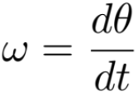
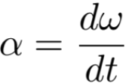



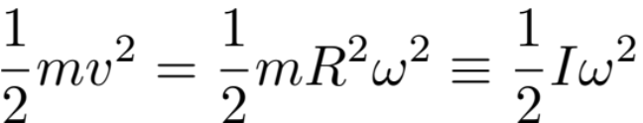

Rotation. Circular motion. Point particle.
We describe rotation around an origin O by a radius R and an angle θ relative to some starting point.
The angle is in radians, so θ = 0 to 2π (=360 degrees).
The angular speed (in rad/s):
The angular acceleration (in rad/s^2):
The distance travelled (in m) is:
The speed (in m/s)is:
The acceleration (in m/s^2) is:
m
v
θ
R
O
Kinetic energy of a particle of mass m is
I is the moment of inertia of the point particle around O.

Slide 6
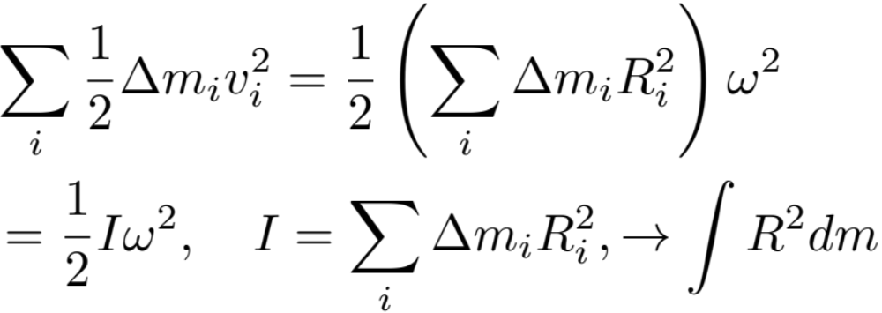
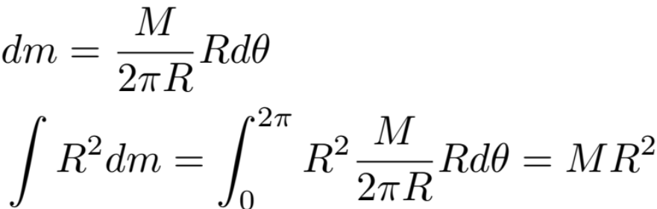
Kinetic energy and moment of inertia of other rigid objects.
Then the kinetic energy of the whole thing is the sum of all the bits:
We can generalise this: Imagine a ridig body where all bits turn together around an axis with the same angular speed.
For a homogeneous ring around its center:
R
M

Slide 7
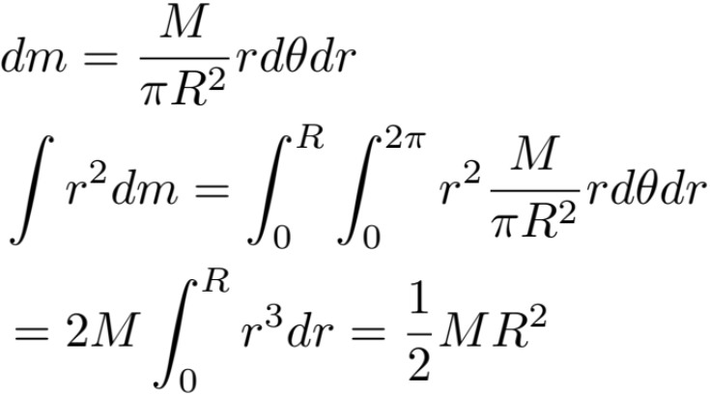

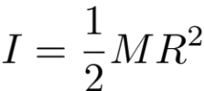
Discs and cylinders
A homogeneous disc,
around its center:
A homogeneous cylinder,
around its symmetry axis:
In general: total I is the sum of component I’s.
R, M
R1,M1
R, M
R2,M2
(sum of discs).

Slide 8
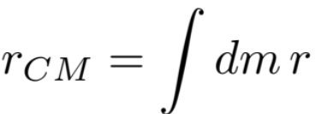
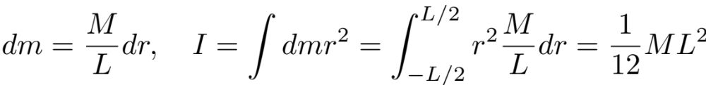
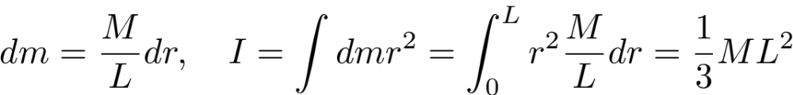
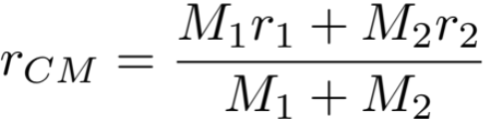
Center of mass and sticks
The center of mass of an object is at a position:
Moment of inertia of (thin) stick around its center of mass:
A homogeneous disc: = O
M,L
O
R, M
Moment of inertia of (thin) tick around its end point:
R1, M1
R2, M2
O
M,L
r_CM
r1
r2
Ex.: What is the moment of inertia for a stick of mass M and length L around a point xL from the endpoint, as a function of x?
O

Slide 9

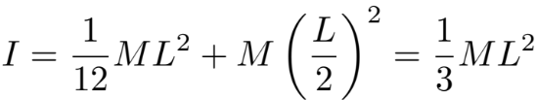


Parallel axis theorem
The axis of rotation matters!
Simple relation, if all you want to do is shift the axis, but not alter its direction: “Parallel-axis theorem.”
M,L
O
A homogeneous disc:
O
M,L
R, M
Usually, moments of inertia are quoted around axes through the center of mass. Different axes give different I.
Around center:
Around parallel axis,
shifted D from center:
If objects are not homogeneous, one has to think…

Slide 10
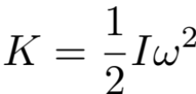

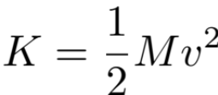
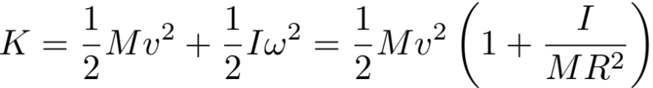
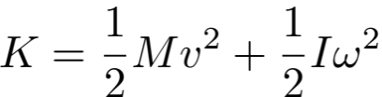
Translational and rotational kinetic energy. Rolling without sliding.
Sometimes, a motion is not just translational or rotational, but both:
Ex.: If wheels rolls without sliding, then rotated distance of circumference is equal to rolled distance:
Just rotational.
Just translational.
Ring: 1
Disc: ½
Both: For instance a wheel rolling down a road.
v: speed of center of mass.
ω: angular speed around center of mass.

Slide 11


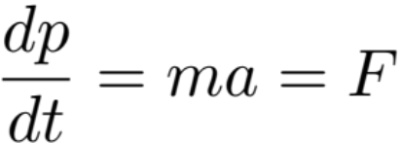
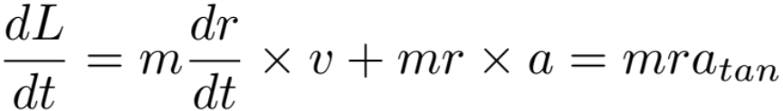

Angular momentum
Momentum:
Angular momentum around a point O:
v-vector
v-tangential
Newton’s 2. law:
Careful! Different L around different O, with the same p!
v-radial
r-vector
L is conserved:
As long as v-tangential is the same. As long as a-tangential is zero.
As long as F-tangential is zero.
O
If F = 0, p is conserved.
F-vector
F-tangential
F-radial
0
r-vector
The Torque of
force F around O.
O

Slide 12
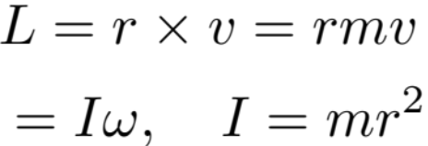
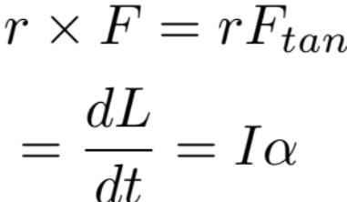
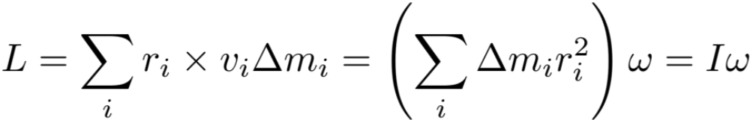
For circular motion and rigid bodies
v-vector
r is constant.
v is tangential.
F-vector
r is constant.
Rigid body: All have the same ω!

Slide 13
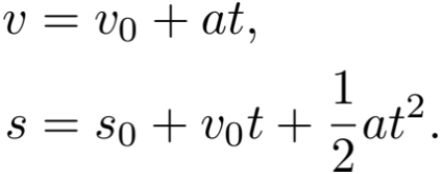
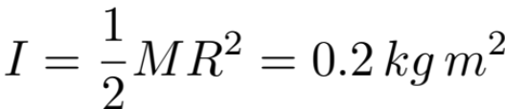
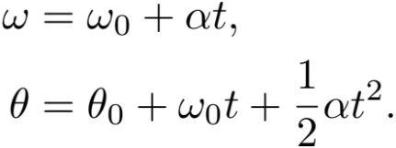
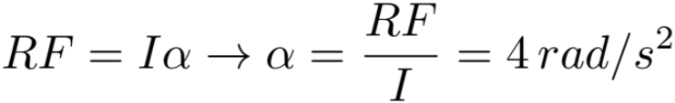
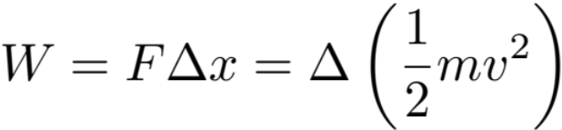
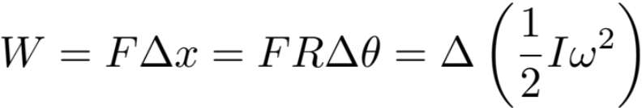
What does it all mean: An example!
Here is a cylinder of Mass M = 10 kg and radius R = 20 cm.
Recall the kinematics of linear motion, constant acceleration:
It has moment of inertia:
Same thing applies for angles:
Now someone comes along and turns it around its axis by a force F= 4 N applied tangentially to the surface of the cylinder.
So one can do the same manipulations, ask about “how long does it take for…”
This gives a constant angular acceleration:
Work and Energy also works similarly:

Slide 14
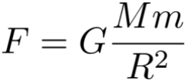
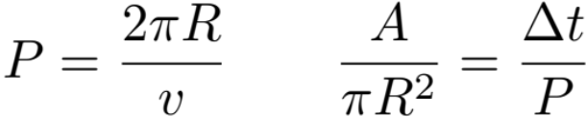
Kepler’s laws for circular motion.
When in a gravitational field, where the force is:
Kepler 2: In the same time interval, the area swept by the radius vector is the same.
Kepler 1: Planets move in elliptic orbits with the Sun at one focal point.
Ellipse: Sum of distances to two focal points is constant.
A
R
v
A
v
a: Semi-major axis
b: Semi-minor axis
a
b
Since distance is constant, speed is constant, angular speed is constant and so same angle in same time.
A circle is a very special ellipse, where the two focal points merge.
R
a = b = R
Period P: constant
Radius R: constant
Area A covered in time Δt:
Constant!

Slide 15
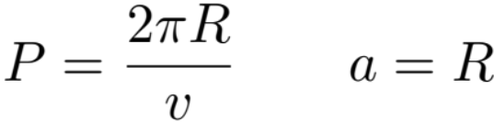
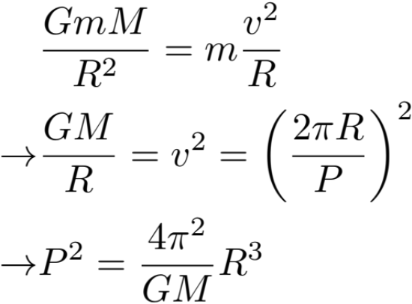
Kepler’s laws for circular motion.
Kepler 3: The orbital period ^2 is proportional to the semi-major axis ^3.
In general, for an ellipse:
Motion is not uniform (speed v is not constant)
Force is not directed at the center, but towards one focal point.
Gives a component that speeds up/slows down motion (parallel to velocity)
And a component just keeping the planet in orbit (perpendicular to velocity).
For circular motion:
Gravity provides the centripetal force:
R
a
b
Then what?

Slide 16
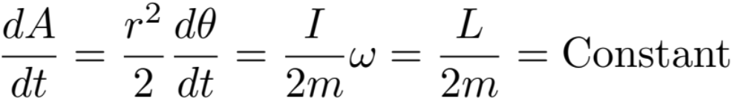
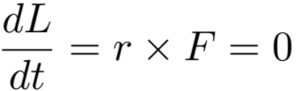
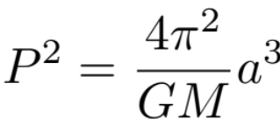
Kepler’s laws beyond circular motion.
When in a gravitational field, where the force is:
Kepler 2: In the same time interval, the area swept by the radius vector is the same.
Kepler 1: Planets move in elliptic orbits with the Sun at one focal point. (Can be proven).
Why?
R parallel to F. No F-tangential.
Kepler 3: The orbital period ^2 is proportional to the semi-major axis ^3.
a
b
(Can be proven. Prefactor must match circular motion case)

Slide 17


A bit of homework
Q1: Find the moment of inertia of a homogeneous disc of mass M and radius R, spinning round an axis through its edge.
Q3: The moment of inertia of a sphere of mass M and radius R around its center is:
Assume that its starts from rest at the top of an incline og height h, and then rolls down. What is its speed at the bottom? What would it have been if the incline had been frictionless, so that it would slide rather than roll?
Q5: The Earth goes around the Sun in 365,25 days. What is the semi-major axis of its orbit?
Q6: I reality, the Earth does not go round a point at the center of ther Sun, but they both go around the joint center of mass. Where is that, given that the mass of the Earth is 6 x 10^24 kg, the Sun 2 x 10^30 kg and the distance between the two 150 million km. How large is that compared to the Sun’s radius, 696 000 km?
Q2: Find the moment of inertia of a inhomogenous thin stick around its center of mass. Assume that the density is:
What is the momentof inertia around either of its ends?
Q4: The Earth has mass 6 x 10^24 kg, a radius of 6378 km and a period of 24 hours. What is its moment of inertia? What is its angular momentum? Assume that it is homogeneous.
How fast would it spin if it suddenly collapsed to the size of the Moon (1737 km)? What would be its period then?

Slide 18
That’s it!
Time for a break and for checking in at the hotel.

